Slide 1


FULL STACK WEB DEVELOPMENT WITH JAVA
Lecture-2
(Servlet)

Slide 2
Today’s Agenda
Servlets Introduction
What Is The Need Of A Servlet ?
Servlet Container
Request and response of Servlet

Slide 3
QUIZ
Q1. What does JEE stand for ?
A. Java Expert Edition
B. Java Enterprise Edition
C. Jakarta Enterprise Edition
D. None Of These
Answer: C

Slide 4
QUIZ
Q2. What kind of applications can be built using JEE?
A. Web Applications
B. Console Applications
C. System Level Applications
D. GUI Applications
Answer: A

Slide 5
QUIZ
Q3. What is a Request ?
A. Message sent by the browser for getting static page
B. Message sent by the browser for getting dynamic page
C. Both A & B
D. None Of These
Answer: C

Slide 6
QUIZ
Q4. What is JEE?
A. A programming language
B. A set of java tools
C. A compiler
D. A platform
Answer: D

Slide 7
INTRODUCTION
A “Servlet” is a server – side application which runs on the server side of a web- connection.
Servlets dynamically extends the functionality of a server.

Slide 8
WHY SERVLET IS REQUIRED ?
To provide Dynamic Behaviour to our website
As we know , HTML can only be used to design the UI of the page i.e. it can be used to generate user interface elements of our application and accept input data.
But HTML has no way to process the data i.e. it does not know what it has to do with this data and how to generate the next repsonse.

Slide 9
WHY SERVLET IS REQUIRED ?
This is where servlets come into the picture.
Thus a servlet is a piece of java code that:
Lives on the server
Gets called by the HTML page
Fetches the data sent by the HTML page
Processes it ( i.e. communicates with the DB or any other resource)
Generates the response as an HTML file
Returns it
This is called dynamic page generation which is the
main responsibility of the servlet.

Slide 10
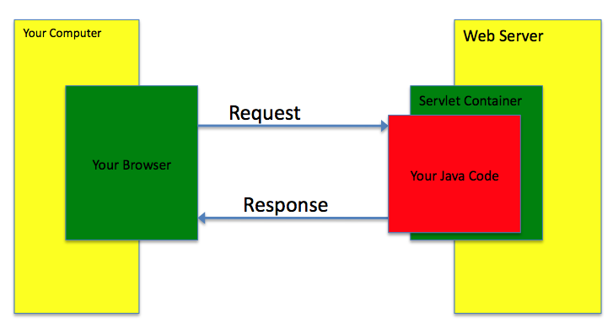
PICTORIAL REPRESENTATION

Slide 11
SERVLET CONTAINER
Servlets don’t have a main() method like a regular java program and they are totally under the control of another special java code called as “Servlet Container”.
When the web server like ( apache, iis) gets request for servlets it doesn’t directly handover it to Servlet, rather this request is transferred to the Servlet Container first.

Slide 12
SERVLET CONTAINER
It is the “Server Container” which gives request to the Servlet takes back response from it and send to the client.
A Servlet container is responsible for managing the lifecycle of servlets, mapping a URL to a particular servlet and ensuring that the URL requester has the correct access rights.

Slide 13
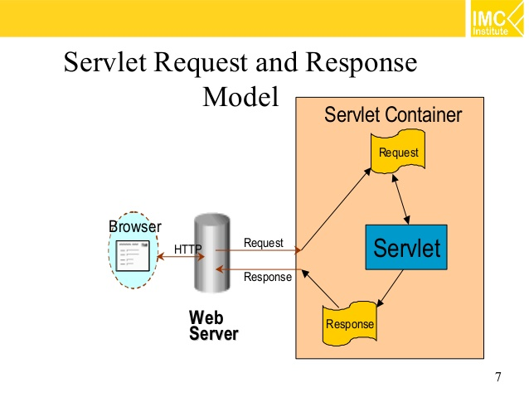
REQUEST-RESPONSE MODEL

Slide 14
STEPS REQUIRED FOR DEVELOPING A SERVLET
Inherit the required interface/classes
Override the necessary methods
Compile the code
Create the appropriate directory structure under the web-server
Place the .class file
Create an XML file by the name of “web.xml” which is called as deployment descriptor file.
Start the web server
Open the browser and request the servlet

Slide 15
INHERITNG THE REQUIRED INTERFACE/CLASS
In order to design servlets we have to create a public class which must inherit an interface called Servlet available in the package javax.servlet.
This interface has 5 methods which are:
getServletInfo()
getServletConfig()
init()
service()
destroy()

Slide 16
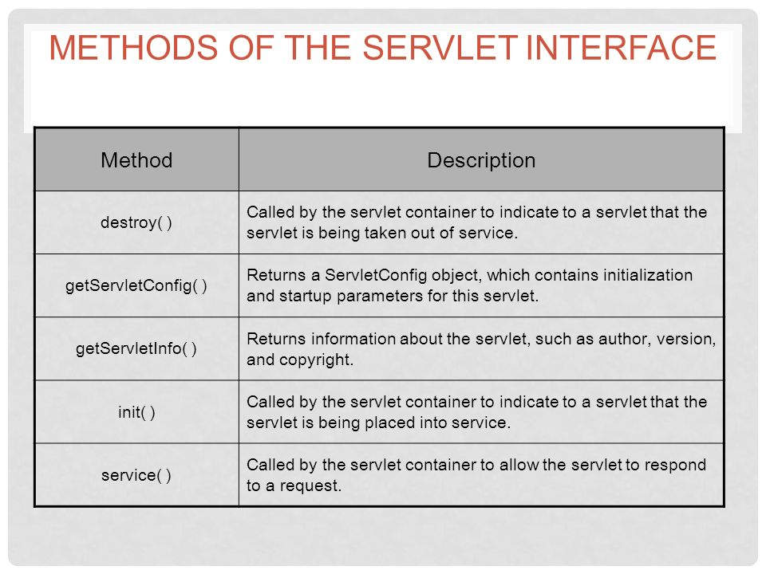
METHODS OF SERVLET

Slide 17

End Of Lecture
For any queries mail us @: scalive4u@gmail.com
Call us @ : 0755-4271659, 9826686245
Agenda for Next Lecture:
Writing the first servlet program
Deploying it in the server
Common Errors
Introduction to HTTPServlet class

